Slide 1
Using Evaluation Results to Learn and Improve

Slide 2
Objectives
Hear findings from high quality AmeriCorps evaluations across a range of focus areas and grantee types
Learn how AmeriCorps grantees are using evaluation results to improve their programs

Slide 3
Panelists
Stephanie Biegler, Child Abuse Prevention Council
Joel Krogstad, St. Paul Neighborhood Network
Peter Rumsey, Habitat for Humanity, International
Amy Hetrick, CNCS
Allyson Augustin, City Year

Slide 4
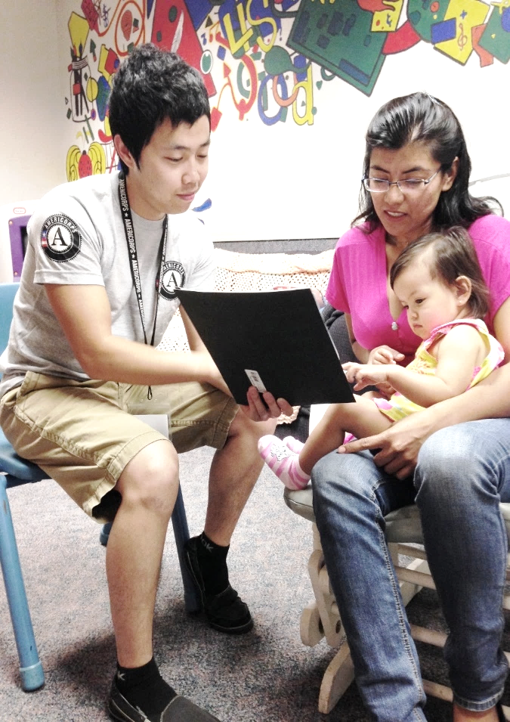
Birth & Beyond
Home Visitation Program
AmeriCorps Impact Evaluation | 2013 - 2015

Slide 5
Birth & Beyond Family Resource Centers
Sacramento County Child Protective Services
Walk-ins, Hospitals, Schools, Community Partners
Family Resource Center
Parenting Workshops
Crisis
Intervention Services
School Readiness
NPP Home Visitation
Differential Response and Aftercare for families with children 0-5 years
Parent Support Line

Slide 6
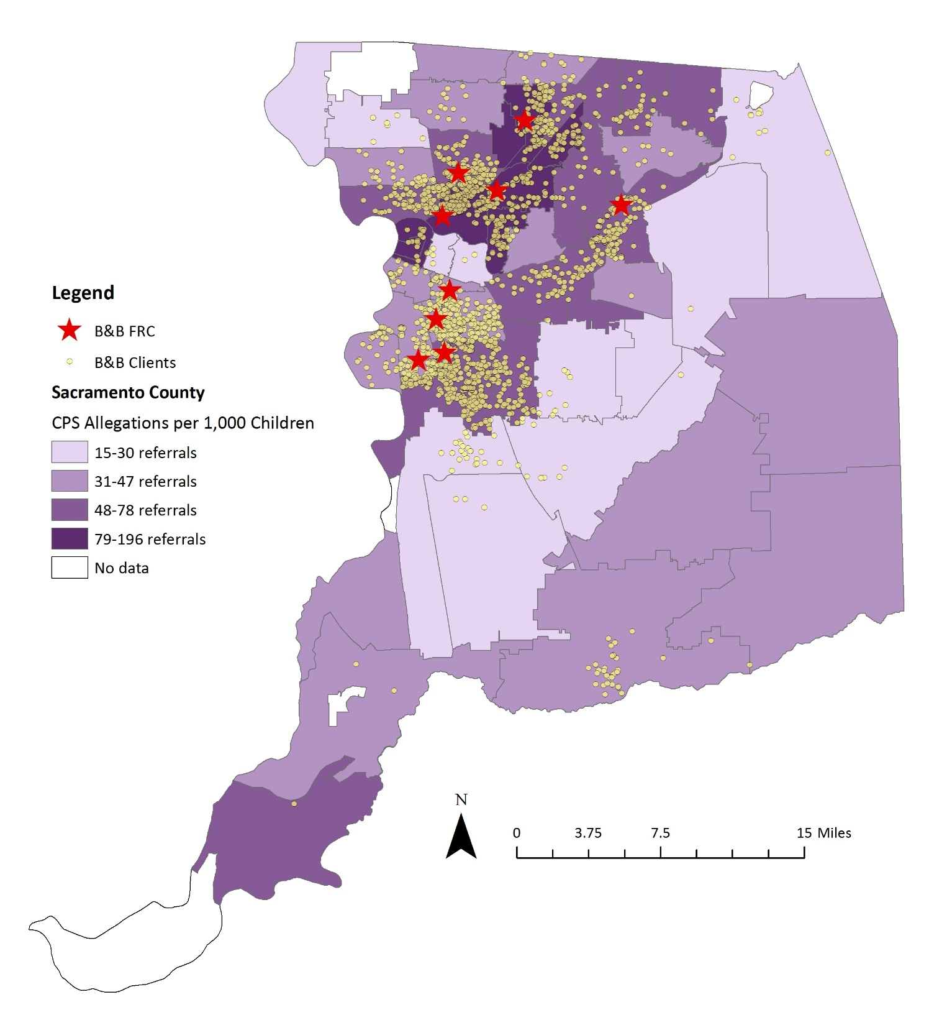
Sacramento County
CPS Referrals by Zip Code

Slide 7
Birth & Beyond | Theory of Change
NEED: Documented high rates of child abuse and neglect are attributable to deficits in parenting knowledge/practices that prevent a child’s healthy emotional/physical development.
INTERVENTION: Members provide at least 8 hours of parenting education through home visits and workshops to high risk parents using the Nurturing Parenting Program to teach parents child development, building empathy, parent/child roles, establishing family routines, and replacements to corporal punishment, to build parenting skills as an alternative to abuse and neglect.
OUTCOMES: Parents demonstrate reduced risk for child abuse and neglect and do not enter/re-enter the child welfare system.

Slide 8
Prior Annual Evaluation| Did Birth & Beyond Parents Have a Reduced Rate of Child Welfare Referrals?
Child welfare ‘look up’ study annually since 2001
Consistently positive results for child welfare outcomes
Half of B&B parents had a prior history of child welfare referral (including as victim)
All B&B parents with at least 8 hours of Home Visitation had a reduced rate of child welfare contact one year after their case closure

Slide 9
Quasi-experimental Study| Will any parent participating in Birth & Beyond have a reduced rate of CPS referrals?
Quasi-experimental study includes all Home Visitation parents, with child welfare history, who were served by an AmeriCorps member in the 2013-2015 program years
Impact evaluation allows for the direct attribution of positive changes to Home Visitation program (i.e., provides ‘higher-level of evidence’ of program effectiveness)

Slide 10
Quasi- Experimental Study
Compares HV parents (n=496) with previous child welfare history to non-HV parents (n=985) with similar child welfare history
Controls for bias that some individuals are more willing/likely to participate in HV program
Accounts for rolling program entries and exits
Holds all demographic factors constant to compare child welfare recidivism over time

Slide 11
Evaluation | Findings
All parents participating in HV were 41% less likely to have a substantiated child welfare referral over a 4-year period than non-HV parents.
Parents with 25-36 hours of HV were 173% less likely to have a substantiated child welfare referral over a four-year period than non-HV parents. (statistically significant at p < 0.05)
Parents with at least 8 hours of HV showed an average decrease in risk/increase in parenting skills as measured by the AAPI (statistically significant at p < 0.01)

Slide 12
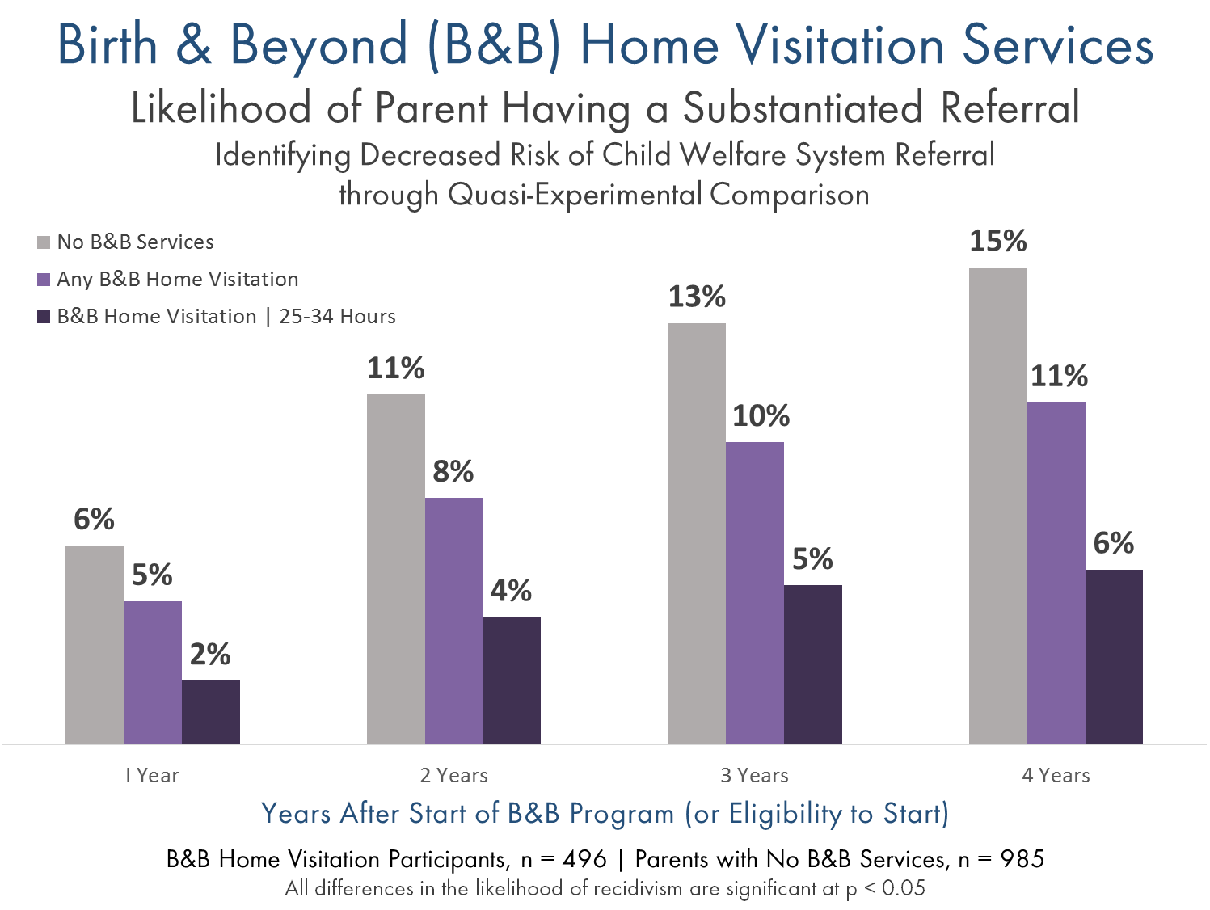

Slide 13
Current Evaluation | Summary
CPS Recidivism | All parents participating in HV have a reduced likelihood of new child welfare referrals.
Optimal Hours | Those parents receiving 25-34 hours of HV have the greatest reduction in the likelihood new child welfare referrals.
The findings of this study provide strong evidence that Birth & Beyond home visitation supports Sacramento County parents and their families by reducing the risk of child welfare referrals after participating in the program.

Slide 14
Evaluation |Recommendations
Consider aligning home visitation dosage towards the optimal 25-34 hour range.
Explore strategies to address program attrition to ensure parents are receiving optimal level of home visitation program dosage.
Consider additional research to explore remaining and emergent questions from this study about effectiveness and impact.

Slide 15
Evaluation Tips from Community
Technology
Empowerment
Project
AmeriCorps Symposium Sept 22, 2016
Joel Krogstad, Program Director
krogstad@spnn.org
550 Vandalia Street, Suite 170 • Saint Paul, MN 55114
www.spnn.org/ctep

Slide 16
35 AmeriCorps members
Teaching technology skills for economic, social and civic empowerment
at 28 community-based partner agencies in Twin Cities, Minnesota
Target Population:
Low-income
Unemployed or Underemployed
Have low technology skills

Slide 17
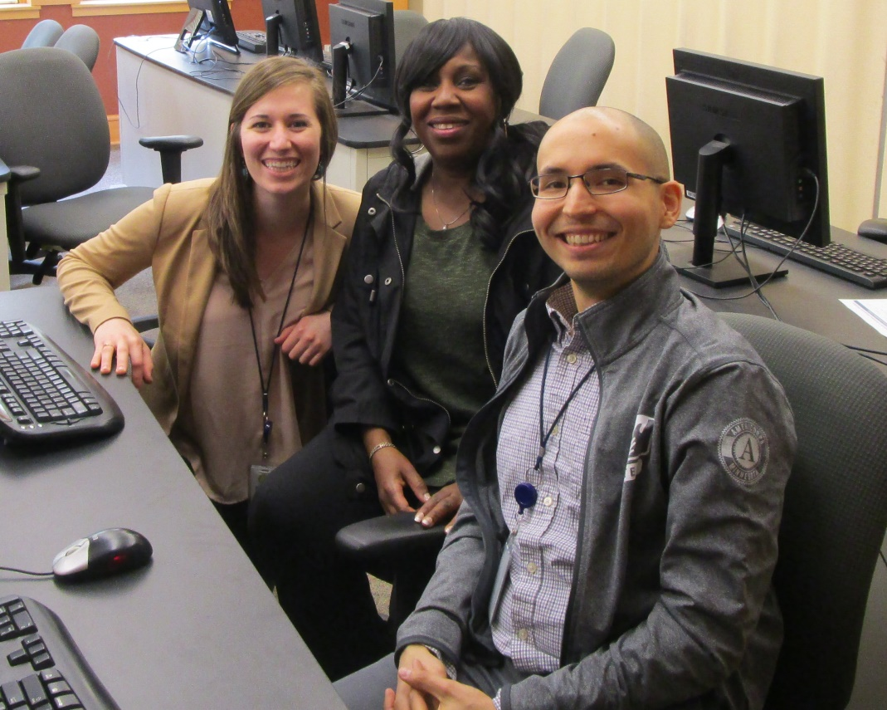
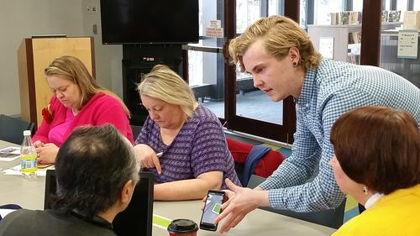
Employment Centers
Libraries
Community Media
Adult Basic
Education

Slide 18
Member Activities/ Theory of Change
Teach classes with NorthStar Digital Literacy Standards
Proctor Assessments to gain basic tech skill certifications for 1500 community members
Assisting community members to use acquired tech skills for job placement: 600 to gain employment

Slide 19
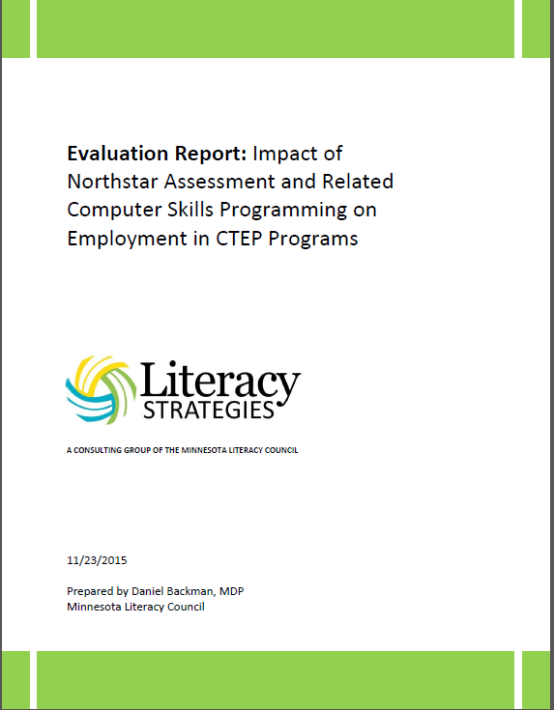

Slide 20
Research questions From a representative sample of adult learners in CTEP programs, we sought to determine….
the employment rate change after attending at least four hours of computer skills programming in a CTEP program.
the employers and job types of those who received employment
how the CTEP employment result compares to a metro wide employment comparison group (DEED).
the Return on Investment for the value of all new jobs received.

Slide 21
Study Design and cost
Quasi-experimental study with a comparison group (DEED)
CTEP members did data collection over course of one program year with evaluator doing study design, instrument creation, training, quality control, analysis, and report write up.
208 surveys administered in 28 of 30 CTEP sites, confidence level 95%
Evaluation cost $7000, for time of the lead evaluator.

Slide 22
Key Findings
80% reported computer class helped look for employment.
71% reported attending computer class helped in getting offered job.
$31,266: average salary, mostly office/admin, sales, personal care
50% found a job within 4 months after class
Beat Employment Result from Comparison Group (DEED): 41% (339/818)
$5.7 million total estimated economic impact of (value of new jobs created)

Slide 23
Learn More! Study posted at www.spnn.org/ctep

Slide 24
Grantee Evaluation Panel
AmeriCorps Symposium
September 22, 2016

Slide 25
What’s the story you want to tell?
Primary
We recommend photos to be at least 1500 x 1000 pixels (150 dpi at 10 x 6.6 inches) but resolution requirements for presentations are dependent upon screen resolution and viewing distance.
Photos from DAN should be downloaded at their highest quality settings.
Can you prove it?
ddd
ddd

Slide 26
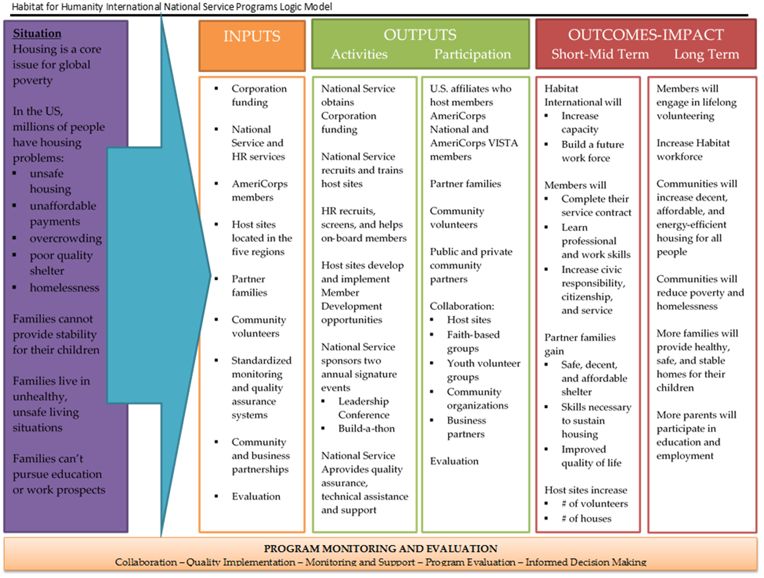
qwerty
Start with…

Slide 27
Add some ph.D’s…

Slide 28
Research Questions: added value?
Do host affiliates (through members) increase capacity compared to similar, non-hosting affiliates?
Serve more families?
Engage more volunteers?
Increase new builds and rehabs?
Do members benefit?:
Obtain full workforce development training and mentorship?
Learn new and transferrable skills?
Increase new and lasting civic
engagement interests?

Slide 29
Surveys and Data Sources
Affiliate and Host Affiliate (Pre-Post)
Completed by leadership
Matched comparison
Impact and added capacity of members on affiliate outcomes.
Member (Pre-Post)
Fall of 2014 to Fall of 2015
Member perceptions
Alumni (Post-only)
Long-term perceptions

Slide 30
Be courageous!
Assumptions should be tested.
The data will set you free!

Slide 31
Do host affiliates experience increased capacity compared to similar, non-hosting affiliates?
Serve more families? YES
Engage more volunteers? YES
Increase new builds and rehabs? YES
Do members benefit?
Value workforce development training and mentorship? YES
Learn new and transferrable skills? YES
Increase new and lasting civic engagement interests? YES

Slide 32
School Turnaround AmeriCorps Overview
A partnership between the U.S. Department of Education and CNCS
13 programs funded in 2013
Programs operate in School Improvement Grant (SIG) schools and Priority schools
Programs coordinate with school leaders and use student data to target interventions
More than 600 AmeriCorps members were approved to provide interventions that are aligned with school turnaround plans in more than 70 schools in 15 states.
Notes:
How School Turnaround is different from other AmeriCorps education programs:
1. School eligibility and no service location changes without pre-approval
2. More intensive coordination with school leadership. CNCS requires a written partnership agreement that addresses specific content to formalize program coordination with school leaders. CNCS also required letters of commitment from school leader and LEA during the application process.
3. Member interventions must align with school turnaround plans.
4. Members are limited to service activities that are within the 6 strategies (next slide). So this means no disaster activities and community service projects must be tied to the identified strategies.

Slide 33
School Turnaround AmeriCorps Overview
Members focus on one or more of the following:
Family and Community Engagement
Addressing Non-Academic Factors that Impact Student Achievement (attendance, discipline, school safety, social and emotional needs, etc.)
Reading and Math knowledge and skill acquisition
Increase Graduation Rates
Increase College Enrollment Rates
Increase Learning Time
Notes:
…through tutoring, mentoring, classroom assistance, etc.
Exact language of 6 strategies:
Providing ongoing mechanisms for family and community engagement.
Establishing a school culture and environment that improves school safety, attendance, and discipline and addresses other non-academic factors that impact student achievement, such as students’ social, emotional, and health needs.
Accelerating students’ acquisition of reading and mathematics knowledge and skills.
Increasing graduation rates through strategies such as early warning systems, credit-recovery programs and re-engagement strategies.
Increasing college enrollment rates through college preparation counseling assistance to include completing the Free Application for Federal Student Aid (FAFSA) and college applications, and educating students and their families on financial literacy for college.
Supporting school implementation of increased learning time.

Slide 34
School Turnaround AmeriCorps Overview
Austin Independent School District
Berea College
Blackfoot Community Center
City Year, Inc.
Communities in Schools of Miami
Denver Public Schools
Detroit Parent Network
Duluth Area Family YMCA
Learning Works
MN Alliance With Youth
ReNEW-Reinventing Education (ReNEW Schools)
Springfield College
Teach For America
Notes:
6 of these programs were brand new to AmeriCorps

Slide 35
School Turnaround AmeriCorps Study Design
Evaluation Design(s): Comparative Case Study, Implementation Study.
Study Population: School leaders and staff, grantee staff, AmeriCorps members, and parents.
Evaluator: Abt Associates.
Notes:
From the very beginning of the planning process for this partnership it was decided that CNCS would fund an independent program evaluation. The programs were required to participate in this evaluation but the programs were not required to conduct their own evaluations.
This was ultimately an implementation study. However, it was initially intended to be an impact study. But given the program model, this was not feasible (challenges finding comparison schools without AmeriCorps). Because there was a planning year built in, it was possible to effectively re-tool the evaluation.
Study methodology comprised both surveys as well as case studies of select schools, such as those that exited SIG status during the program. These reinforced each other and helped build confidence in the study findings. Important to highlight that useful information can be found in studies that aren’t RCTs or QEDs.

Slide 36
School Turnaround AmeriCorps Research Questions
How was the School Turnaround AmeriCorps program implemented in schools?
How did school leaders perceive the impact of AmeriCorps services?
What about the program model and AmeriCorps service contributed to or hindered these results?

Slide 37
School Turnaround AmeriCorps Findings
Findings: How was the School Turnaround AmeriCorps program implemented in schools?
Overall, AmeriCorps members and program partners implemented program interventions as intended.
Program start-up and grant administration challenges typically associated with launching a new program became less prevalent.
Other common challenges to the AmeriCorps program model persisted, including member recruitment, retention, and role definition.

Slide 38
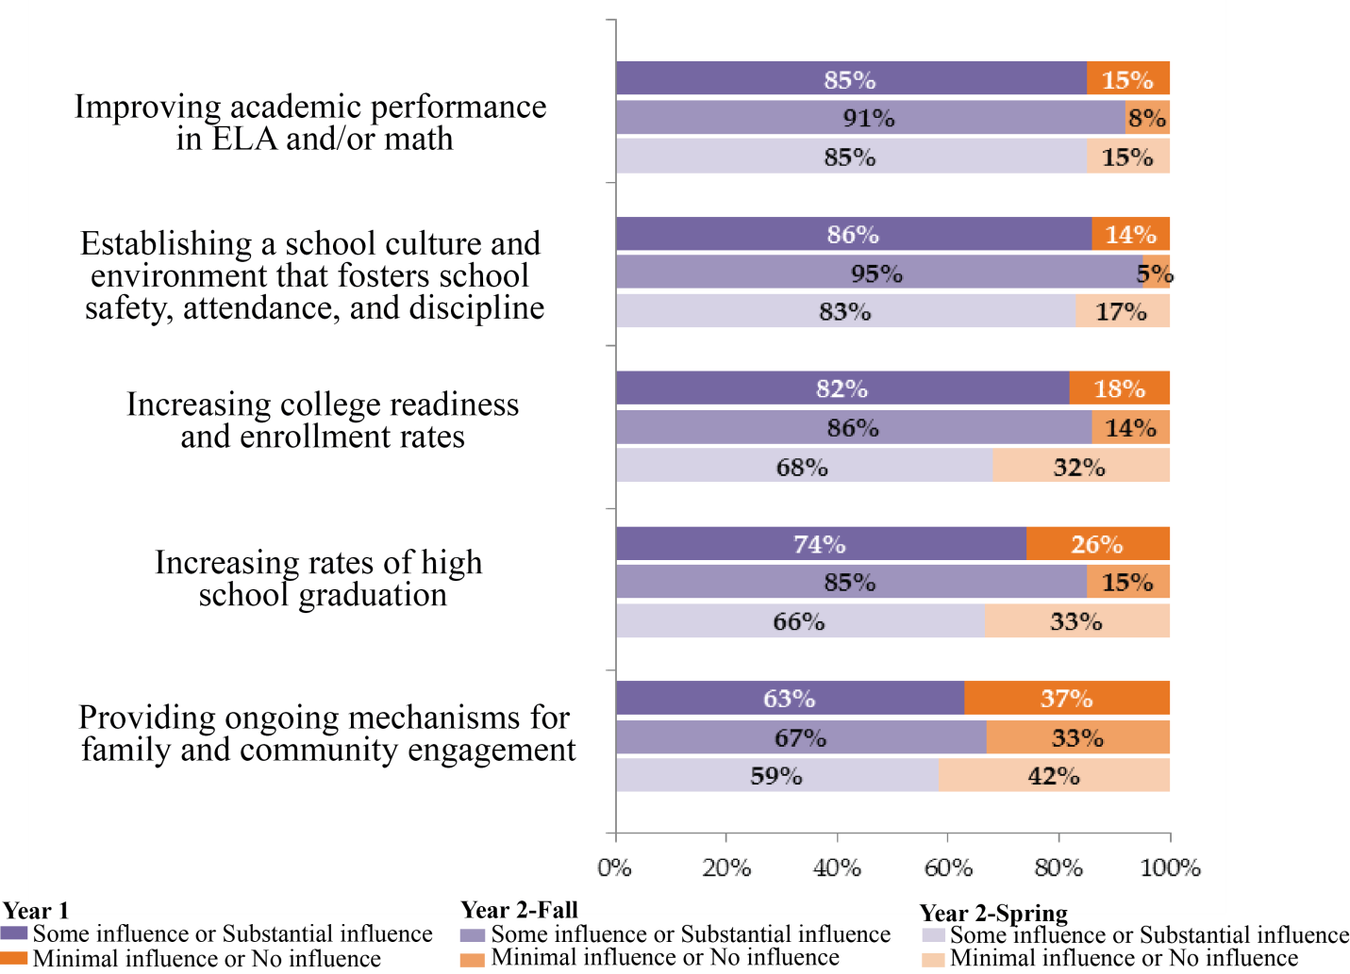
School Turnaround AmeriCorps Findings
Findings: How did stakeholders perceive the impact of AmeriCorps services?
Notes:
At all three points in time, at least a majority and in many cases an overwhelming majority of stakeholders perceived the impact of AmeriCorps services as having some or substantial influence in key areas that aligned with the goals of AmeriCorps service in the schools. The areas in which stakeholders were more likely to perceive members as having minimal influence or no influence are not surprising because these are the areas that members were less frequently engaged.

Slide 39
School Turnaround AmeriCorps Findings
Findings: What about the program model and AmeriCorps service contributed to or hindered these results?
The quality of communication and relationship building with school stakeholders
The quality of member training and consistency of services
The quality of the school-based service delivery
Notes:
Programs’ focus on communication and relationship building with school stakeholders helps
build program buy-in,
increase program understanding, and
ease challenges inherent in serving in low-performing schools, such as high turnover of school leaders and staff.
Programs ensure member quality and consistency by
improving member recruitment and retention,
providing specialized member training and preparation, and
providing on-site supervision and support.
Members effectively deliver school-based services by
establishing trusting relationships with students,
maintaining a consistent presence to aid with classroom management,
collaborating with teachers to review student data and target supports to students’ needs,
and being flexible in meeting schools’ needs.

Slide 40
PREPARATION FOR IMPACT STUDY
Having strong performance measures that can be easily collected, have methods in place of following up with participants months after intervention
Have your AmeriCorps staff undergo training on evaluation fundamentals

Slide 41
Five take-aways for affordable, strong americorps evaluation
#1 Choose Quasi-Experimental Design!
#2 Evaluator does not need a lot of extravagant credentials.

Slide 42
Five take-aways for affordable, strong americorps evaluation
#3 Two Year Eval Process
Year 1: study designed and tested
Year 2: study carried out, with leadership from returning members

Slide 43
Five take-aways for affordable, strong americorps evaluation
#4 Have Members do Data Collection. Find a Comparison Group that already collects the data you need
#5 Buy-in from members from beginning of service year, not something thrown on the members mid-year

Slide 44
School Turnaround AmeriCorps Key Learnings - CNCS
Planning year allowed the evaluation to be redesigned in order to provide meaningful information.
Clarified member roles and rolled out new expectation to update written partnership agreement annually were included in 2016 NOFO.
Portfolio calls were held on year 1 evaluation findings; discussion also held at Symposium.
Clarifying GPR instructions to grantees, including expectations for when goals are exceeded and the need to report on School Turnaround AmeriCorps programming discretely.

Slide 45
School Turnaround AmeriCorps Key Learnings – City Year
What learnings did City Year take away from being part of the School Turnaround evaluation, and what changes have we made as a result?
Reduce data burden for members and standardize in-school trainings
Continue investing in on-site staff coordinator per school
Focus on youth development training for our members
Notes:
Overall this evaluation has helped us to refine our program model by identifying areas of strength and weakness and providing recommendations for improvement.
Specific ways we applied learnings:
1) The report helped us to underscore the value of member-teacher relationships and using test scores and other data to target students alongside teacher referral. However the Year 1 evaluation corroborated our own member survey findings, that their experience trying to manage per student data entry was too burdensome. Resolving our data management processes is part of a larger project that we are undertaking to improve our members’ experience overall. Solutions have included:
Ongoing efforts to partner with districts for whole class data uploads,
Rebuilding our student level database to be more intuitive and user friendly for the corps
Mobile apps to record data on site for our members, working with schools to access their technology systems (routers in schools)
Revised team role assignments to distribute admin burden equitably
2) The report helps us explain our costs. Our model relies on a staff member assigned per school which increases our expense per member. This report helps to demonstrate why that position is so important. It underscores the need for extensive member training and preparation, also a cost driver. Lastly it affirms that when members are in schools full-time, all day, they build stronger relationships with students.
3) The Year 2 report emphasizes the role AmeriCorps members play in student socio-emotional development and that it was recognized as a key driver to student progress and overall school improvement. Developing this kind of evidence represents a challenge, as it typically relies on individual student surveys – hard to do when working with large numbers of students across multiple school districts and with variable access to test scores. The finding confirmed the value of student socio-emotional health as a program focus and affirmed our investment in youth development training for our corps, who often are unfamiliar with the high stress school environments they will be supporting.

Slide 46
School Turnaround AmeriCorps Key Opportunities – City Year
What opportunities did participation in the School Turnaround evaluation represent for City Year?
Learning from and share with the STA community of practice
Using findings to validate and promote our program model
Notes:
We have been able to learn from our fellow STA participants about best practices for member retention, trouble shooting data sharing and program components new to City Year (such as home visits). We also benefited from expertise from DOE representatives (i.e. on FERPA regulations).
The full report (Years 1 and 2) affirms our Whole School Whole Child model and serves as a rationale for continued investment by our stakeholders and sponsors. We ask our partner schools for a lot -- funding, staff time, school resources, access to school meetings and professional development opportunities for our members, and trust with students. The report provides critical evidence that our approach works and is worth the investment.
We will use this report (in conjunction with our other evaluations) in meetings with prospective and current sponsors, with our partner school districts and individual schools to help support our case for continued investment and conditions for success. Key meetings occur in March-June each year as school budgets are confirmed.
We expect to share findings through press releases and social media, and as part of editorials supporting continued investment in AmeriCorps as a strategy for what works.

Slide 47
School Turnaround AmeriCorps Evaluation Planning
Strategies for managing cost
Tips for hiring and managing an external evaluator
Using STA evaluation as part of body of evidence
Notes:
Strategies for managing cost can include:
running an RFP process and accepting the most competitive bid;
partnering with another agency as stakeholder who can share costs or data collection activities;
Using a third party consultant to help control costs (e.g. Bee’s Knees Consulting)
Tips for hiring and managing an evaluator:
Prior knowledge of content area and program design
How evaluator copes with specific challenges, such as missing data sets
See rubric for more examples
Body of evidence:
The STA evaluation supports our City Year body of evidence which includes national and city-specific impact evaluations. This report provides rich descriptive detail. Because it blends City Year with other programs, it helps us validate the premise that with conditions for success and best practices in place, regardless of the location of the school, national service plays a critical role in school turnaround efforts.
Our long-term research agenda seeks to demonstrate that sustained investment in City Year partnerships with schools in feeder patterns positively affects student achievement across whole classes, whole grades and whole schools and will result in improved graduation rates. The STA report provides evidence that our approach towards school partnerships is likely to lead to this outcome.
Experience working with evaluators:
CNCS program staff, research and evaluation staff met frequently with evaluators to ensure that the evaluation was on track. Program staff clarified requirements and program design specifics and helped evaluators overcome data collection challenges. CNCS also reviewed interim evaluation products to allow us to start using findings as soon as possible and inform new research questions as the evaluation progressed. We didn’t want to wait until the end of the two years to start learning from the evaluation.

