Slide 1
Creating a Service Opportunity Listing in eGrants

Slide 2
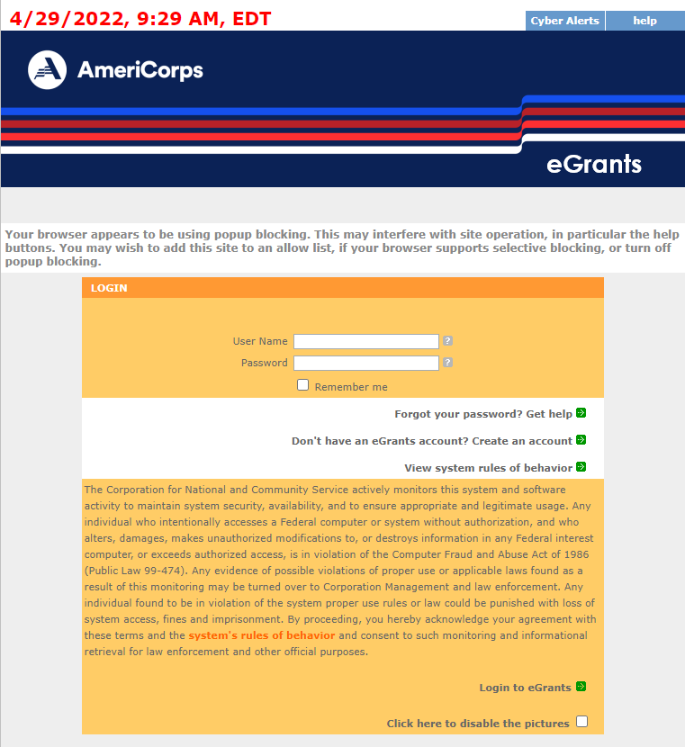
Login to eGrants
Enter in User Name and Password
Then click Login to eGrants
Notes:
Login to eGrants, then enter

Slide 3
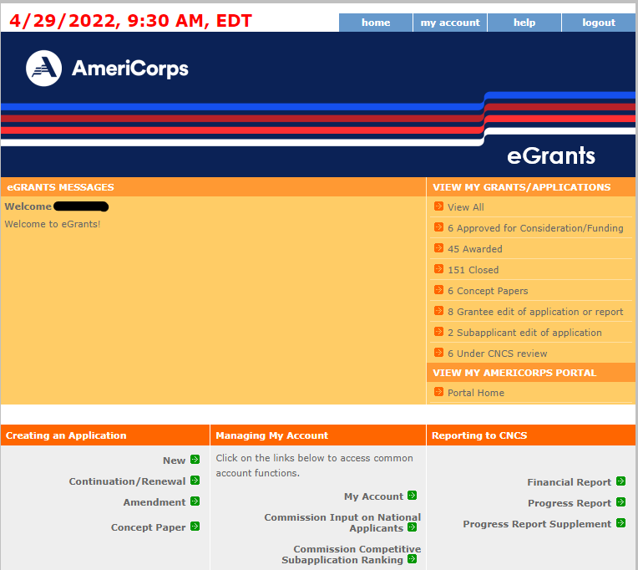
Login to Portal Home
Click on the Portal Home link under View My AmeriCorps Portal

Slide 4
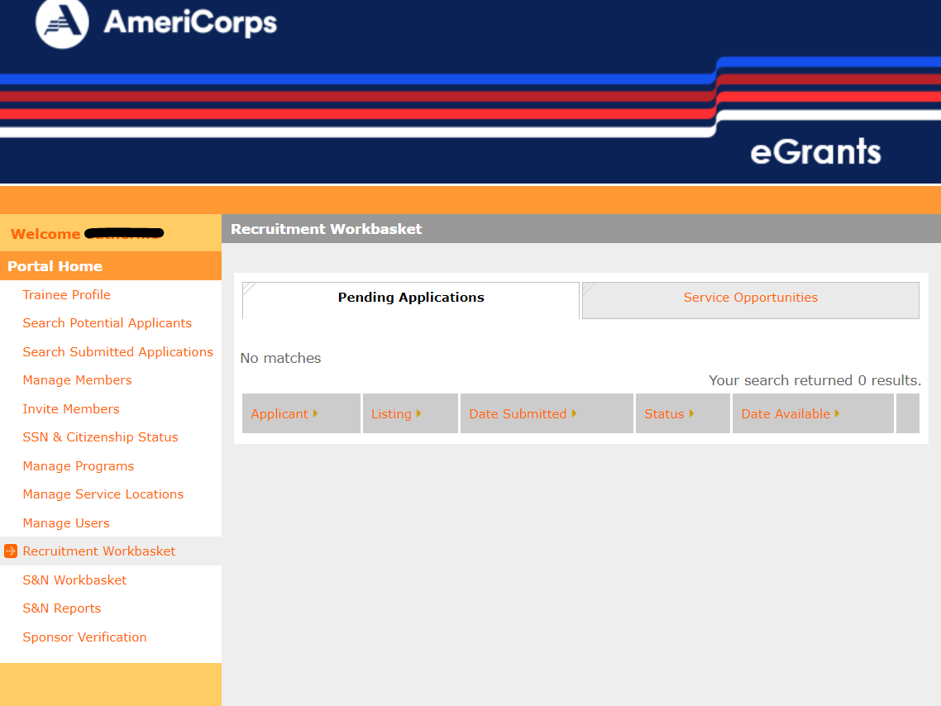
Navigate to Recruitment Workbasket
Click on the Recruitment Workbasket from Portal Home menu

Slide 5
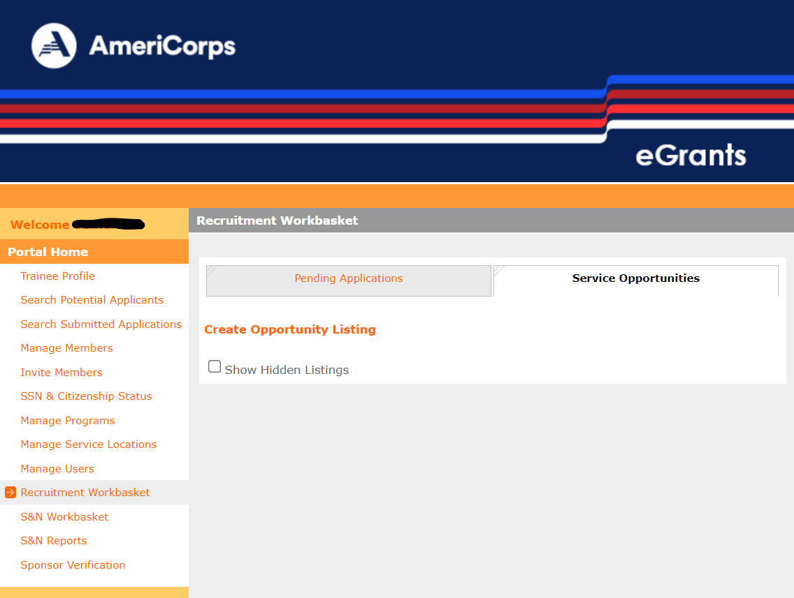
Navigate to Service Opportunities
Click on the Service Opportunities from the top tab selection

Slide 6
Navigate to Create Opportunity Listing
To create a new Service Opportunity Listing, click on Create Opportunity Listing at the top of the page

Slide 7
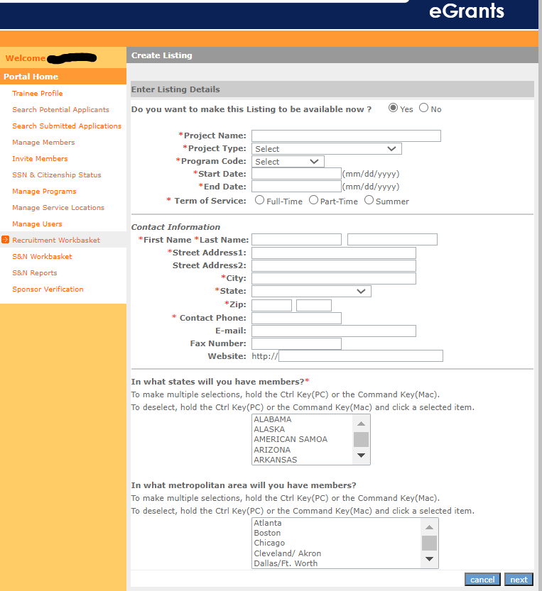
Input information – page 1
Input the following required information, as indicated by a red asterisk* or by AmeriCorps policy:
Project Name
Project Type
Program Code
Start and End Dates
Term of Service
Contact Information
State(s) or Territories of service
Optional information:
Listing availability (default “Yes”)
Metropolitan areas
Click Next
Note: Information cannot be saved until final submission

Slide 8
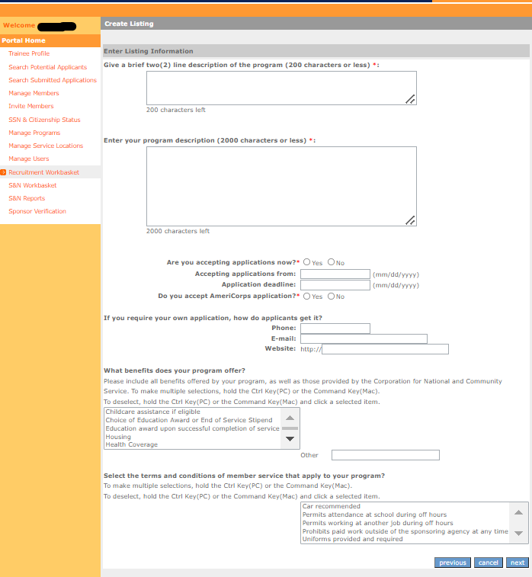
Input information – page 2
Input the following required information, as indicated by a red asterisk* or by AmeriCorps policy:
Two line description headline
Program description
Accepting applications (Yes/No)
Application deadlines
Alternate applications (Yes/No)
Member benefits
Optional information:
Alternate application information
Terms and conditions
Click Next

Slide 9
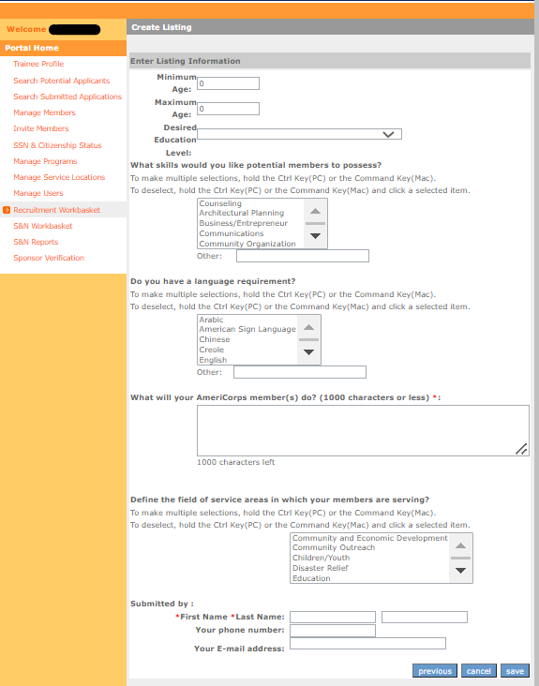
Input information – page 3
Input the following required information, as indicated by a red asterisk* or by AmeriCorps policy:
Minimum Age
Maximum Age
Member activities
Modification comment – if editing a listing
Submitter name
Optional information:
Desired education level
Member skills
Language requirement
Service areas
Submitter contact information
Click Save to submit to AmeriCorps

Slide 10
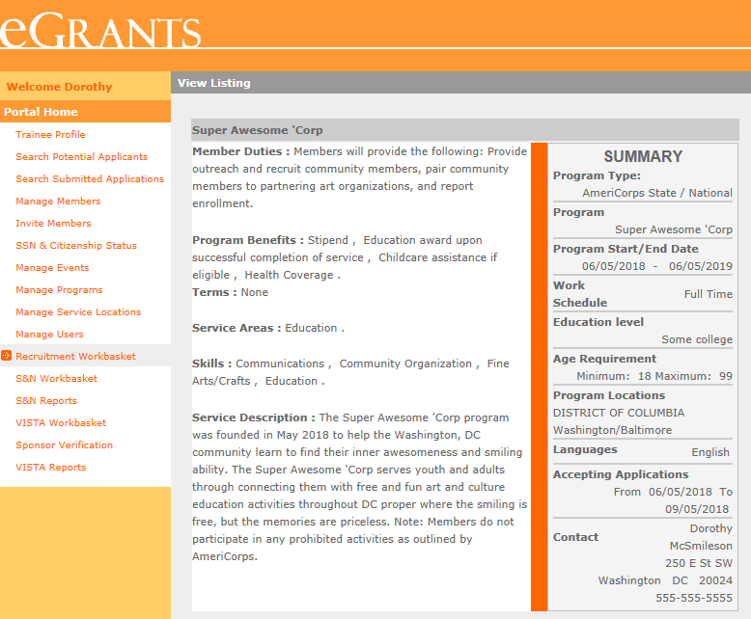
View Service Opportunity Listing
After clicking Save, the screen will display your newly submitted Service Opportunity Listing
Review the Service Opportunity Listing and if changes are required, navigate back to the Service Opportunities in the Recruitment Workbasket to edit

Slide 11
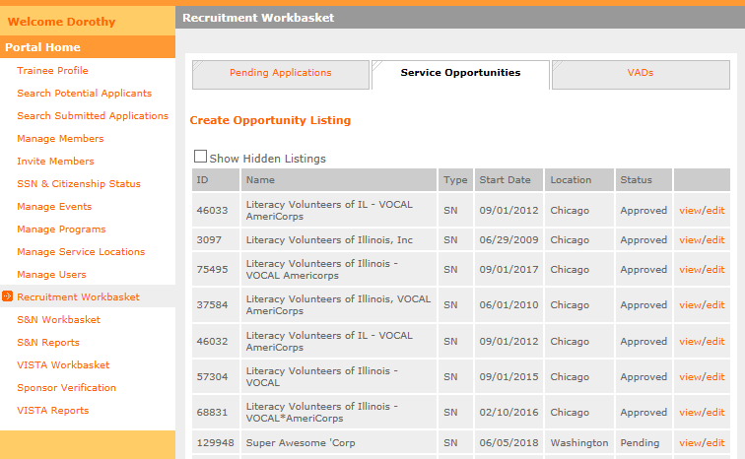
View Submission Status
Service Opportunity Listings Status:
Pending – awaiting to be viewed by AmeriCorps.
Approved – viewed by AmeriCorps and approved submission. Listing is now viewable, if indicated by submitter.
Denied – viewed by AmeriCorps and disapproved submission. Listing needs to be edited and resubmitted.
Note: Every time a listing is edited, it is resubmitted with a new timestamp and listings are reviewed chronologically by AmeriCorps. If you do not wish to edit and adjust the timestamp, select view.

Slide 12
Resources
Resources for drafting compliant Service Opportunity Listings are available at:
americorps.gov/grantees-sponsors

Slide 13
Suggested listing language
Suggested listing language Gain valuable professional experience or help an organization expand its capacity, while making an impact in your community. [ORGANIZATION] is looking for [X] [FULL-TIME/PART-TIME] AmeriCorps member(s) with a passion for public health to serve on our team. You’ll support with [PROJECT TASK, e.g., pandemic relief, improving health equity, increasing access to mental health services]. Apply today to help strengthen your local community through national service with Public Health AmeriCorps, a joint partnership between AmeriCorps and the Centers for Disease Control and Prevention.
The more specifics you can provide about the type of activities your members will be supporting, the better. That said, be conciseness and to the point in outlining member duties so applicants don’t have to read through big blocks of text.
Avoid using ‘job’ as a way to talk about your service opportunities, and be sure the living allowance isn’t confused with a salary. This helps manage expectations for potential members.
Be sure to list your organization’s PHA point of contact so that prospective applicants can get in touch for more information.

